Slide 1
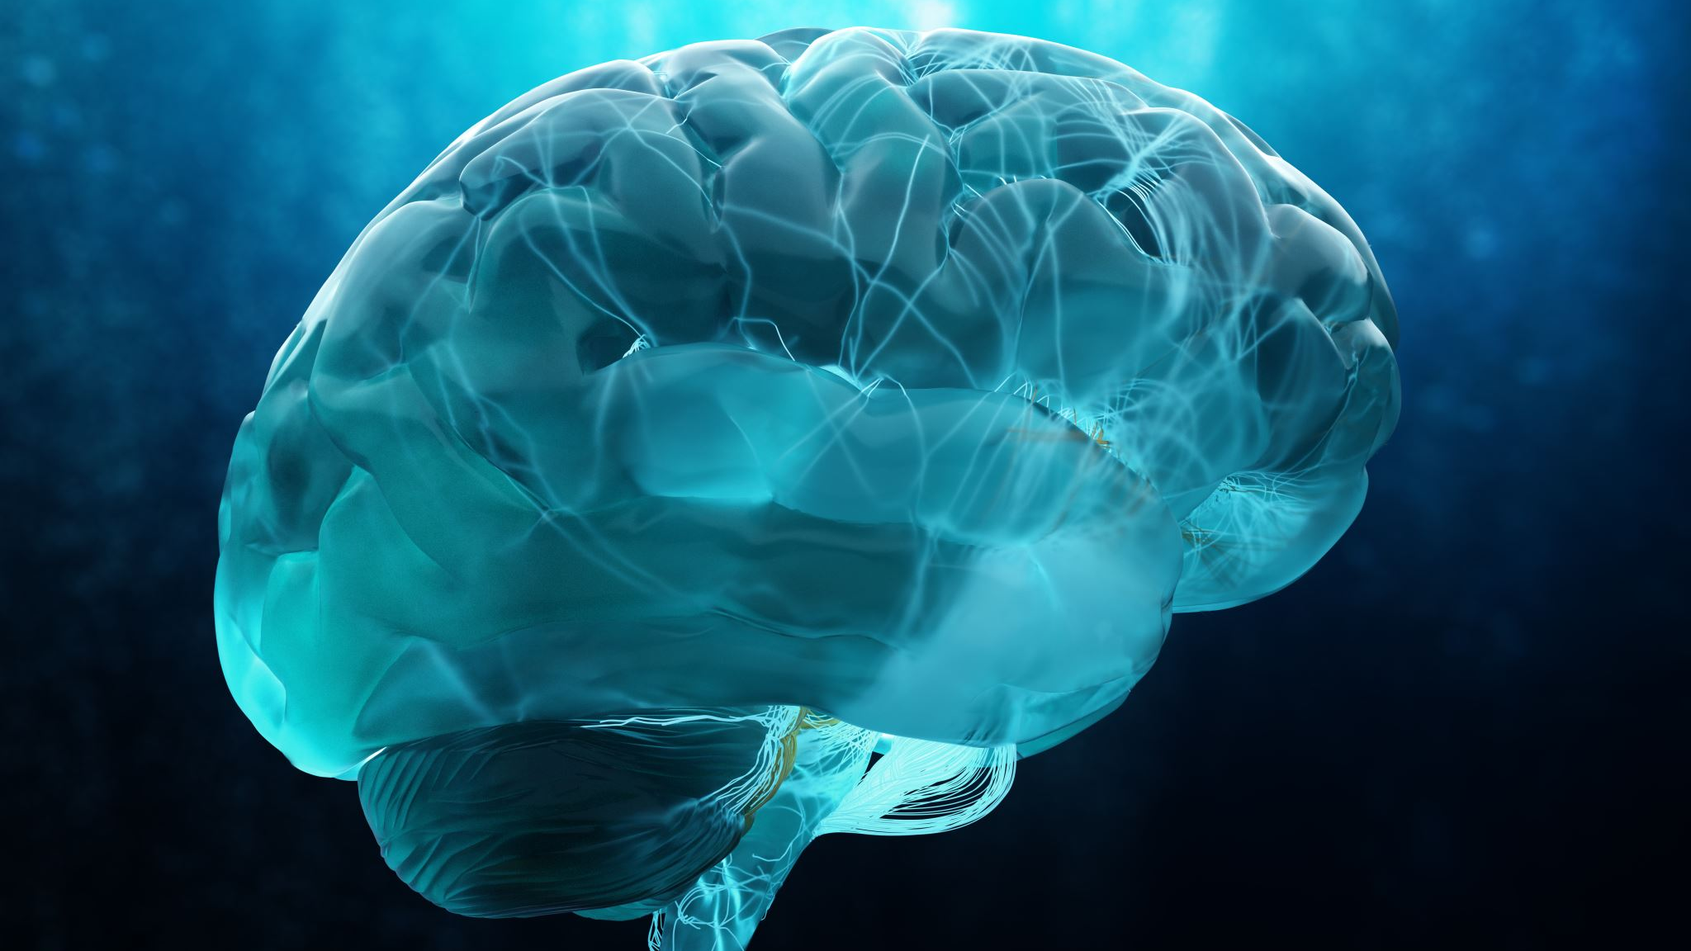
The Personalized Brain
David Buzorgnia
June 2023

Slide 2
Why do we need a mathematical model?
The aim of science is not just to predict the future, but to understand the underlying mechanisms and principles of operation and to answer the fundamental question of "why." By leveraging prior knowledge, we can explore and discover these mechanisms (Ramezanian-Panahi, M., 2022).
While Deep Learning draws inspiration from the brain, its purpose is not to replicate the brain's structure or function. Instead, it is designed to be executed by computers, leveraging computational power for efficient processing.
When it comes to the brain, modeling and simulating both the micro and macro scales pose significant challenges with the current technology.

Slide 3
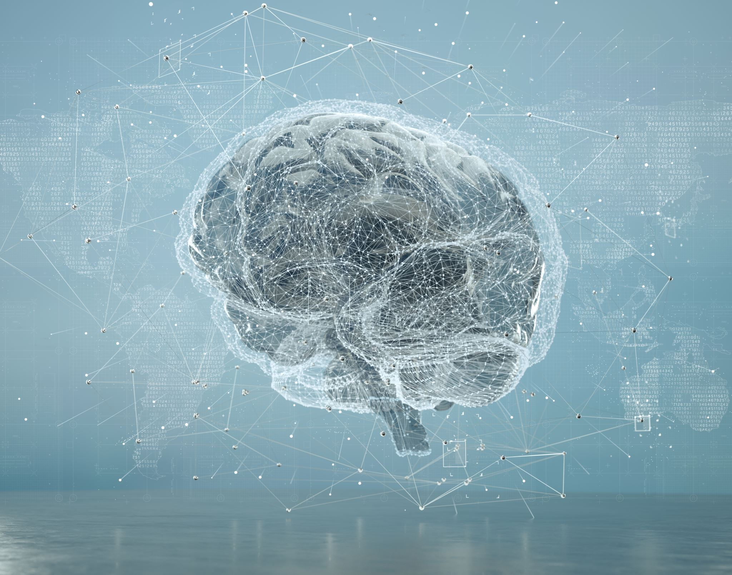
A Personalized Model
Obtaining a personalized model presents two significant challenges:
Limitations of brain imaging techniques: Current imaging techniques fall short in capturing the micro-scale details of the brain, both structurally and functionally. The resolution and precision required to accurately model individualized brain characteristics are not yet achievable with existing technology.
Computational limitations of computer hardware: Building a model that encompasses the entire structure of the brain and effectively imitates its functional activities is hindered by the current limitations of computer hardware. The computational power required for such a comprehensive model is beyond the capabilities of existing systems.

Slide 4
Thrita’s Goal
Thrita is dedicated to utilizing the capabilities of current medical equipment and computer hardware to develop a brain model that closely mirrors the real structure and function of the brain. The primary objective is to enhance our understanding of the complexities of the brain and provide physicians with a valuable tool for improved diagnosis and treatment strategies.
This ambitious goal is pursued through a commitment to ongoing advancements in medical equipment and computer hardware. By capitalizing on progress in these areas, Thrita aims to continuously refine the brain model, striving for greater precision and accuracy over time. The ultimate aim is to empower physicians with a reliable and effective resource that aids in enhancing patient care.

Slide 5
Micro-Scale Modeling
At the micro-scale level, Thrita employs neurobiology principles to model the membrane potential of neurons, incorporating second-order dynamics.
To enhance accuracy, we have expanded upon the traditional Leaky Integrate-and-Fire model. Our updated model takes into account the nonlinearity of the membrane potential when approaching the threshold, while ensuring computational efficiency for execution on computer systems.

Slide 6
Macro-Scale Modeling
In order to capture the large-scale network of the brain, we utilize graph theory as a powerful tool for defining and analyzing networks.
Graph theory enables us to model plasticity, accounting for possible future development, by incorporating dynamical equations into the edges of the network.

Slide 7
Macro-Scale Modeling
When defining the network connectivity, we first establish anatomical connections:
Each neuron is assumed to have an anatomical connection with its immediate neighbors.
For long-range connectivity, we employ Diffusion Tensor Imaging (DTI), a technique that is currently undergoing development. However, it is worth noting that the utilization of DTI presents challenges, particularly in areas like the corpus callosum, where incorrect tracts may arise.

Slide 8
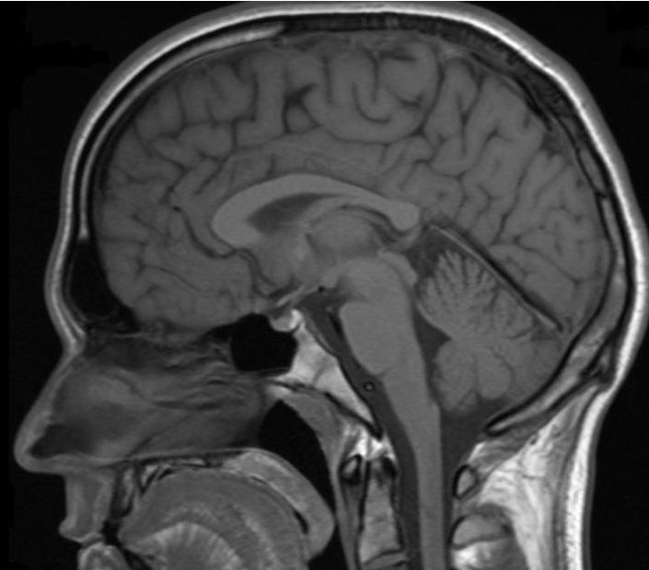
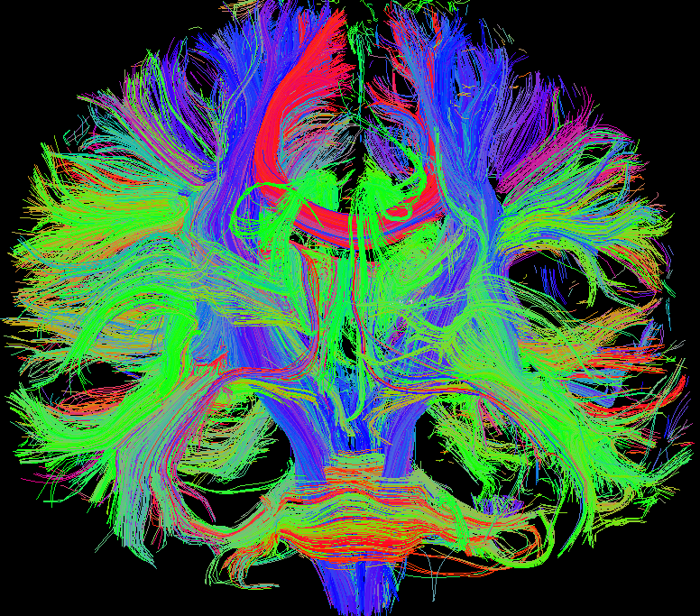
Macro-Scale: Structure
To ensure a realistic representation, the neurons in the macro-scale model are positioned within a 3D space based on the T1 weighted image. This approach aims to closely mimic the spatial arrangement of neurons in the actual brain. | For establishing long-range anatomical connectivity, the ongoing development of Diffusion Tensor Imaging (DTI) is utilized. DTI enables the visualization and mapping of white matter tracts, allowing for the incorporation of long-range connections within the brain model.

Slide 9
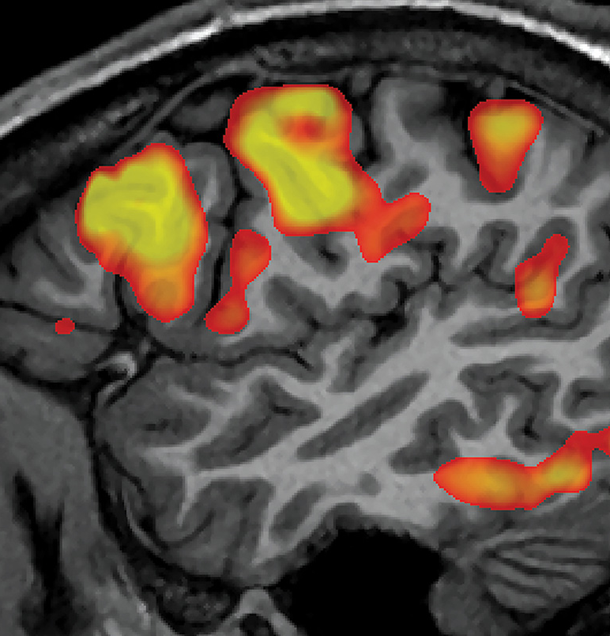
Macro-Scale: Functional Connectivity
To complement the anatomical connectivity established in the previous step, Thrita incorporates functional connectivity analysis using functional Magnetic Resonance Imaging (fMRI).
By integrating the information from anatomical connectivity and functional connectivity obtained through fMRI, Thrita strives to create a macro-scale brain model that not only reflects the structural aspects but also captures the dynamic functional interactions within the brain. This comprehensive approach provides a deeper understanding of the brain's functional connectivity patterns.

Slide 10
Model Characteristics
The brain model exhibits several unique characteristics, including:
Based on 1.5T MR: The model is constructed using 1.5 Tesla MRI scans, resulting in a configuration of 56,000 neurons, each exhibiting its own dynamic behavior. It is worth noting that higher-quality images obtained at a larger number of Tesla can potentially accommodate a greater number of neurons within the model.
Anatomical and Functional Connectivity: The Thrita brain model incorporates over 1,300,000 defined links that capture both anatomical and functional connectivity between neurons. These connections play a critical role in simulating the intricate network dynamics and functional interactions within the brain.

Slide 11
Model Characteristics
Analysis Flexibility: The model offers a flexible analysis approach, allowing for investigations at different scales. Researchers can explore the entire brain as a unified system or zoom in on specific regions or individual neurons. This versatility facilitates in-depth examinations of specific neuronal behavior and interactions, as well as a holistic understanding of the brain's overall functioning.

Slide 12
Analysis: In Vivo Stimulation
The dynamic nature of the brain model enables us to investigate how the brain responds to external stimulation and observe the communication and collaboration among neurons within their local neighborhoods and with other brain regions. This experimental approach can be referred to as "simulating in vivo stimulation.”

Slide 13
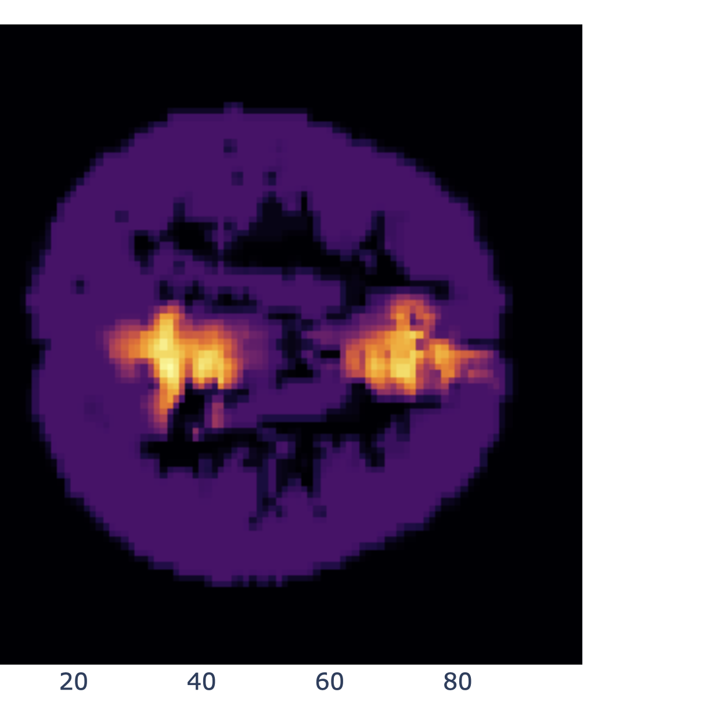
Analysis: In Vivo Stimulation
The accompanying picture depicts a slice of the personalized brain model, showcasing the functional activity in response to stimulating the cingulate gyrus. By simulating such stimulation, we can gain insights into the dynamic patterns of neuronal activity and observe how different regions of the brain interact and contribute to overall brain function.

Slide 14
Analysis: Biomarker
In recent years, there have been significant studies investigating the link between changes in brain functional activity and the progression and prediction of diseases such as Alzheimer's Disease (AD) and Mild Cognitive Impairment (MCI) (Hojjati, S.H., 2019; Ibrahim, B., 2021).
We have conducted an analysis involving the computation of personalized brain models for three different subjects: AD, MCI, and Normal Control Subject (NCS). In these models, we stimulate the cingulate gyrus and measure the synchronization of functional activity in the neighboring regions with respect to the cingulate gyrus.
This analysis aims to identify biomarkers linked to specific diseases by examining synchronization patterns in response to stimulation. These insights into functional connectivity alterations can aid in developing diagnostic tools, monitoring diseases, and identifying new therapeutic targets.

Slide 15
Biomarker: AD – Functional Synchronization

Slide 16
Biomarker: MCI – Functional Synchronization

Slide 17
Biomarker: NCS – Functional Synchronization

Slide 18
Future Direction: Structure
The structure of the cortex comprises five distinct layers, with each layer exhibiting the potential for firing at different frequencies. Additionally, different regions of the brain can display variations in frequency profiles.
In our ongoing project, we are investigating the firing frequencies in different parts of the brain. Specifically, we aim to study the firing frequencies of different layers within each brain region.
Based on the insights gained from these investigations, our future direction involves constructing two cortical layers within the personalized brain model. Each section of the brain will be assigned a specific firing frequency pattern, reflecting the diverse frequency characteristics observed in different brain regions.

Slide 19
Future Direction: Connectivity
DTI algorithms, although valuable, can occasionally generate erroneous tracts, leading to uncertainties in the personalized brain model. To mitigate this issue and enhance the accuracy of connectivity mapping, we propose employing a filtering approach that incorporates known anatomical tracts.
In our future direction, we aim to integrate the output of the DTI algorithm with reliable anatomical information. By leveraging established knowledge of the brain's anatomical connectivity, we can filter and refine the DTI-derived connectivity data, reducing the presence of false connections and enhancing the reliability of the personalized brain model.

Slide 20
Future Direction: Function
Predicting disease trajectory solely based on a single image sample poses challenges and can lead to reduced accuracy in both prediction and diagnosis. For instance, distinguishing between Alzheimer's Disease (AD), Mild Cognitive Impairment (MCI), and Normal Control Subjects (NCS) has proven challenging for many machine learning methods. Notably, machine learning techniques often fall behind the diagnostic abilities of physicians, particularly in the MCI stage.
One of the unique characteristics of the Personalized Brain model lies in its extensive set of dynamic equations that underpin its functionality. Leveraging the dynamic nature of the model, we have the potential to predict disease trajectories. However, to accomplish this, access to multiple datasets at different time points for each subject is essential.

Slide 21
Future Direction: Function-EEG
Despite its strengths, one drawback of fMRI is its limited temporal resolution. To address this limitation and gain a more comprehensive understanding of functional activity, we plan to incorporate EEG analysis into the Personalized Brain model alongside the combination of MR images.
The next step in our research involves collecting EEG data concurrently with fMRI scans. This approach allows us to explore the potential correlation between EEG and fMRI signals, providing valuable insights into the relationship between electrical brain activity and hemodynamic responses.

Slide 22
Future Direction: Task Scenarios
Resting-state fMRI (rs-fMRI) is a widely adopted method for studying the functional activity of the brain. One advantage of rs-fMRI is its ability to minimize uncertainties associated with patient movement compared to task-based fMRI.
In rs-fMRI, the focus is primarily on measuring the default mode network (DMN) of the brain, which provides valuable insights into the overall brain status and intrinsic functional connectivity.
As part of our future direction, we aim to design task scenarios specifically tailored for EEG and subsequently fMRI. These task scenarios will target functional activity in networks beyond the DMN. The tasks will be carefully designed to be easily understandable for subjects of varying backgrounds while minimizing movements to maintain data quality.

Slide 23
References
Ramezanian-Panahi, M., Abrevaya, G., Gagnon-Audet, J. C., Voleti, V., Rish, I., & Dumas, G. (2022). Generative models of brain dynamics. Frontiers in Artificial Intelligence, 147.
Hojjati, S.H., Ebrahimzadeh, A. and Babajani-Feremi, A., 2019. Identification of the early stage of Alzheimer's disease using structural MRI and resting-state fMRI. Frontiers in neurology, 10, p.904.
Ibrahim, B., Suppiah, S., Ibrahim, N., Mohamad, M., Hassan, H.A., Nasser, N.S. and Saripan, M.I., 2021. Diagnostic power of resting‐state fMRI for detection of network connectivity in Alzheimer's disease and mild cognitive impairment: A systematic review. Human Brain Mapping, 42(9), pp.2941-2968.

Slide 24
Thank You

