Slide 1
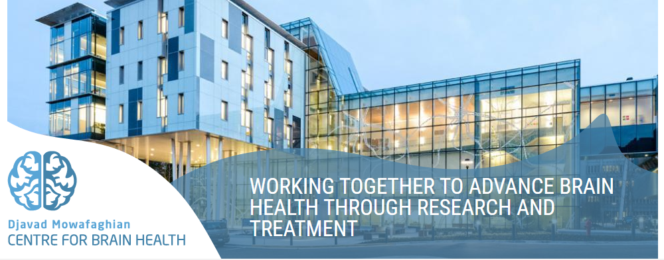
Design and implementation of a “Magic Mirror” to alleviate Hypomimia in people with Parkinson’s disease
Martin J. McKeown: Head of Pacific Parkinson’s Research Center Maryam S. Mirian: Machine learning Research Associate Michelle Doo: McKeownLab Manager

Slide 2
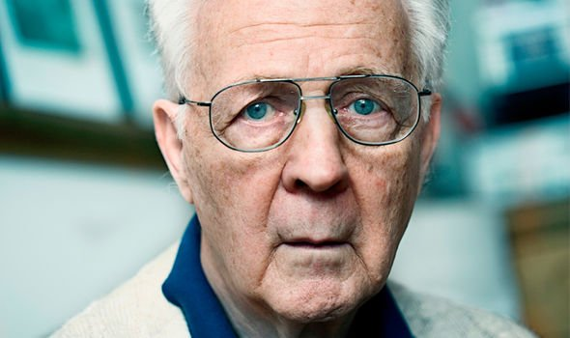
Background
Hypomimia = 'facial masking' – refers to a reduction of facial expressions.
A common symptom of Parkinson’s Disease (PD) characterized by slower and less pronounced facial movements.
Facial masking can cause stigma and dehumanization because other people can struggle to pick up on emotional or nonverbal cues.
It can affect a person's quality of life by making them feel isolated and lonely.

Slide 3
Helping the people to get less Parkinsonian
This application can re-generate the image of the patients in real-time, but augmented with less hypomimia, and more joy or happiness emotions.
This technology will be used to create a therapeutic intervention, whereby patients will practice daily to be able to show more colorful facial expressions.
2

Slide 4
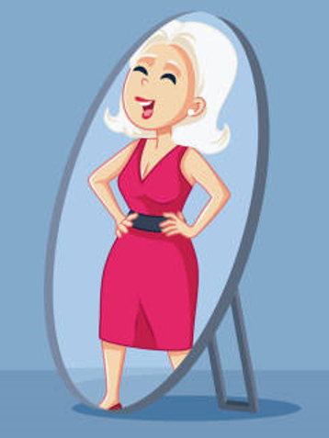
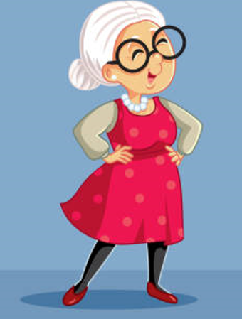
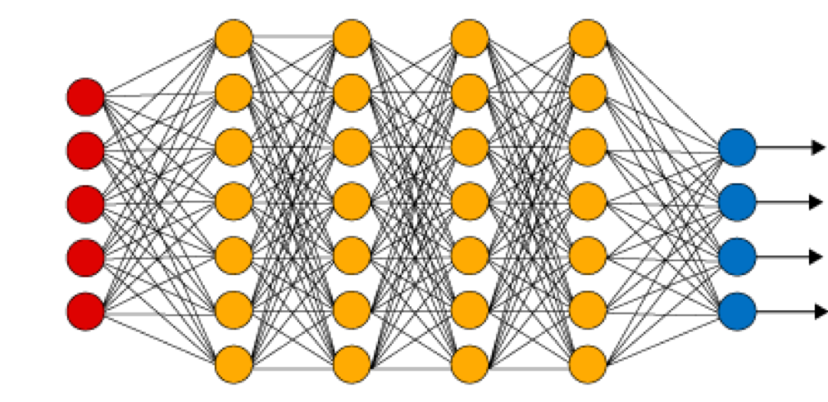
Less Parkinsonian
Deep Learning

Slide 5
Main Objectives
Use Data Driven models to find different features of face
Trying to manipulate different features of face
Determine if there are distinct clusters of facial problems in PD subjects
Elaborate more on the mechanism underlying hypomimia, including motor, emotional, and cognitive alterations
Saving data to further analysis
5

Slide 6
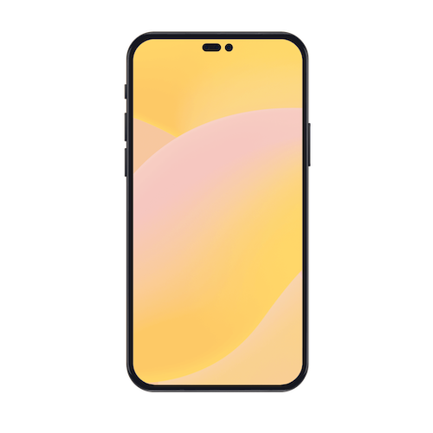
Processes Will be done in Application
Face Detection
Face Manipulation
Analysis of Characteristics of Patients
3

Slide 7
Eye Blinking
Aspects of PD we want to measure
Drooling of Saliva
Lips Parted
4

Slide 8
Methods
The work will be based on StyleGAN, a network whose latent space allows for image manipulations.
For instance, MaskFaceGAN, a styleGAN-based network, manipulates face images concerning several facial attributes with exceptional quality and at high resolutions using a latent code optimization procedure.
There are public datasets such as CelebA-HQ, Helen and Siblings-DB-HQf to sufficiently train the network and later fine-tune it with local PD data collected at UBC.
We hope that by processing the facial PD features, we can also determine if there are distinct clusters of facial problems in PD subjects and elaborate more on the mechanism underlying hypomimia, including motor, emotional, and cognitive alterations.

Slide 9
Main Deliverables
An application: Magic Mirror for PD
Design and development phase documentations
Evaluation of the App on 30 patients with PD and evaluation of its effect in terms of probable improvements of some key facial features that the neurologist in the management team will guide.
6

Slide 10
Evaluation in the Clinic
Let's say that their training consists of mimicking an avatar on the screen. Imagine they have to stare at the screen, the screen is divided into two halves.
One is their picture and the other is an avatar character. What they're instructed to do is to mimic the facial expression of the Avatar.
In the control condition, their face is just like a mirror.
And then in the test condition, it's their face that's been modified to be less Parkinsonian.
we would have to have some sort of metric of facial expressivity.
We test the hypothesis that the people who had their face that was modified would have more facial expression after a three week training period, compared to the people who just had their mirror fed back to them

